Slide 1
שפת LETREC שפת "וייסוג" שפה עם פרוצדורות רקורסיביות Recursive Procedures and Scopes
EOPL3 Sections 3.4 - 3.7

Slide 2
The LETREC Language
All of PROC, plus …
Concrete:
Expression :: = letrec Identiﬁer (Identiﬁer) = Expression in Expression
AST:
letrec-exp (proc-name bound-var proc-body letrec-body)

Slide 3
value of a letrec expression
(value-of
(letrec-exp proc-name bound-var proc-body letrec-body)
ρ)
= (value-of letrec-body
(extend-env-rec proc-name bound-var proc-body ρ))

Slide 4
(extend-env-rec pnm bvar pbdy ρ)
Let ρ1 == (extend-env-rec proc-name bound-var proc-body ρ)
(apply-env ρ1 proc-name) = (proc-val (procedure bound-var proc-body ρ1))
(apply-env ρ1 var) = (apply-env ρ var)

Slide 5
environment datatype
(define-datatype environment environment?
(empty-env)
(extend-env
(var identifier?)
(val expval?)
(env environment?))
(extend-env-rec
(p-name identifier?)
(b-var identifier?)
(body expression?)
(env environment?)))

Slide 6
apply-env
(define apply-env (lambda (env search-var)
(cases environment env
(empty-env () (report-no-binding-found search-var))
(extend-env (saved-var saved-val saved-env)
(if (eqv? saved-var search-var)
saved-val
(apply-env saved-env search-var)))
(extend-env-rec (p-name b-var p-body saved-env)
(if (eqv? search-var p-name)
(proc-val (procedure b-var p-body env))
(apply-env saved-env search-var))))))

Slide 7
Scoping : Free (non-local) Variables
proc main()
int x := 5;
proc q()
{ x := x + 1;}
proc r()
{int x := 0;
q();
}
{ r();
print(x); }.
Static scoping
x -> x
output: 6
Dynamic scoping
x -> x
output: 5

Slide 8
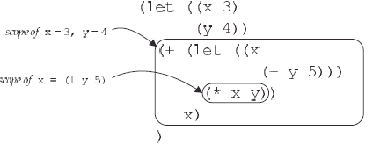
Fig 3.13 Contour diagram

Slide 9
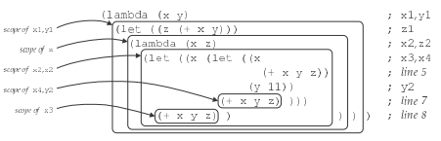
Figure 3.14 Contour diagram

Slide 10
Binding Rules
A variable declared by a proc is bound when the procedure is applied.
(apply-procedure (procedure var body ρ) val) = (value-of body (extend-env var val ρ))
A let-variable is bound by the value of its right-hand side.
(value-of (let-exp var val body) ρ) = (value-of body (extend-env var val ρ))
A variable declared by a letrec is bound using its right-hand side as well.
(value-of (letrec-exp proc-name bound-var proc-body letrec-body) ρ) = (value-of letrec-body (extend-env-rec proc-name bound-var proc-body ρ))

Slide 11
procedure datatype
(define-datatype proc proc?
(procedure
(body expression?)
(saved-nameless-env
nameless-environment?)))

Slide 12
apply-procedure
(define apply-procedure
(lambda (pc val)
(cases proc pc
(procedure (body saved-nameless-env)
(value-of body
(extend-nameless-env val saved-nameless-env))))))

Slide 13
Processing Procedure Invocations
>(run "let x = 1 in
let f = proc () x in
(f)")
1
>(run "let x = 1 in
let f = proc (x) x in (f 2)")
2
Static scoping
>(run "let x = 1 in
let f = proc () x x = 5
in (f)")
1
Dynamic scoping
>(run "let x = 1 in
let f = proc () x
x = 5
in (f)")
5

Slide 14
Lexical Scope Pros and Cons
Scope of names is known to the compiler.
Permits type checking by compiler
Easily check for uninitialized variables
Easier to analyze program correctness
Recursion is harder to implement

Slide 15
Dynamic Scope Pros and Cons
Meaning of variables known only at run-time.
Cannot perform type checking before execution
Programs are flexible, but harder to understand
Easy to implement recursion
Renaming in the caller can effect the semantics of a program

Slide 16
Dyn Binding Can be Difficult
Exercise 3.29: … dynamic binding may be exceptionally difficult to understand. For example, under lexical binding, consistently renaming the bound variables of a procedure can never change the behavior of a program.But under dynamic binding, this transformation is unsafe.
For example, under dynamic binding, the procedure proc (z) a returns the value of the variable a in its caller’s environment. Thus, the program
let a = 3
in let p = proc (z) a
in let f = proc (x) (p 0)
in let a = 5
in (f 2)
returns 5, since a’s value at the call site is 5. What if f’s formal parameter were a?

